Slide 1
Leadership Styles: Why choose?
Tailoring your leadership style to a custom fit for you and your organization
Jill Dixon- Director of Public Services
Nancy Abashian- Head of Reader Services
& Resource Sharing
Notes:
Hello, and welcome to Binghamton University, we are so happy to have you here. I am Nancy Abashian, Head or Reader Services and this my colleague, Jill Dixon, Director of Public Services. Together, we are going to explore with you two leadership frameworks, how to use them and how to identify ways in which your style can be put to work within your organization.

Slide 2

Discussion Agenda:
Leadership a la carte
Leadership frameworks
  Four Frames
  Primal Leadership
Identifying your framework
  Know thyself
  Know thy framework
Practice and application
  Planning and implementing
  Lasting motivation for change
Leadership in Libraries
Further Discussion
Notes:
We thought we would begin by setting an agenda for this discussion beginning with an idea we’ve coined “leadership a la carte”. This will be the first step to introduce you to the myriad of styles out there, how they relate to you and the circumstances you might need to put them to work in.
Though there are many, we will focus on two of our favorite frameworks. For Jill, this is the Four Frames approach and for me, a framework called Primal Leadership.
After spending time with these frameworks, we will begin looking at helping you to identify a framework that seems to appeal to you. Understanding who you are and the role you play within your organization are critical to choosing a framework that is effective for you in the long run.
We’ll talk about practice and application of your style within these frameworks, followed by leadership and the challenges we face within libraries and then follow up with additional discussions.

Slide 3
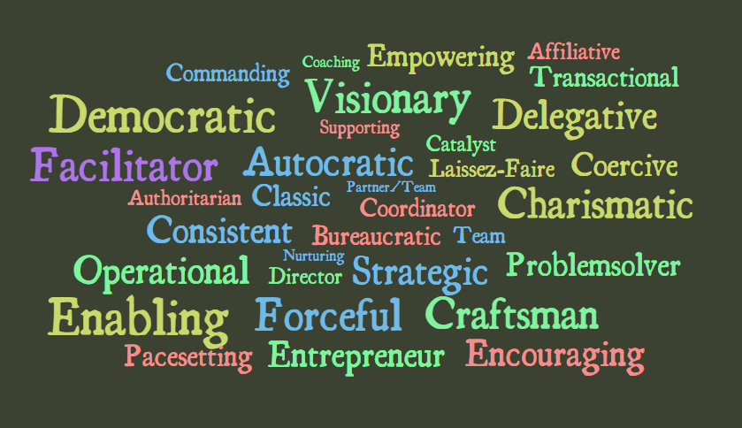
Leadership a la carte:
Notes:
As we dig in, I just want to flesh out a general definition of leadership style vs. leadership framework. So, in this case, style is really just the characteristics which define you. Do any of these words here stick out to you as something that you identify with in terms of personality characteristics or traits? Keep these words and the corresponding definitions we’ve provided, a sort of menu for you to choose from, keep them in mind as we build out some framework for you to plug these styles into. These styles are unique to you, knowing what to do with them once you’ve identified them is the challenge, that is where the frameworks will come in handy as we move forward.
Before I start talking about the Four Frame Approach, we have a leadership questionnaire for you to fill out. There are no right or wrong answers. I’ll give you a few minutes to fill it out.
Now, to plot the results – please add up the numbers and list them on the lines provided as follows:
A’s – ST
B’s – HR
C’s – PL
D’s - SY
Now turn the page and plot those numbers on the appropriate axis on the chart. A higher number demonstrates a stronger propensity for this frame – which I’ll discuss further.

Slide 4
Four Frame Approach
Human Resource
Structural
Political
Symbolic
Notes:
In 1991, Lee G. Bolman and Terrence E. Deal, well-known researcher on organizational development, published a book titled: Reframing Organizations: Artistry, Choice and Leadership.
In this book, the researchers pulled from different organizational theories from several disciplines to develop the “Four Frame” approach to organizational development as well as individual leadership style.
Four Frames are: Structural, Human Resources, Political, Symbolic.
These frames provide the tools to analyze organizations and work situations with the ultimate goal of building a stronger organization.
As I discuss each frame, I’ll talk about it from both the larger organizational perspective and the viewpoint of individual leadership styles. Bolman and Deal provide imagery as way to view the different organizational frames. In addition, I’ll discuss different emphasis for each frame, as well as assumptions and actions dealing within these frameworks.

Slide 5
Structural
Image: Machine
Frame Emphasis: Rational, Formal
Assumptions
  Organization exists to achieve goals
  Specialization increases efficiency
  Coordination ensures integration of individuals & groups
  Organizations work best when rationality prevails
  Structure must align with organizational goals & tasks
Action: Analysis
Reframing Complexity: A Four Dimensional Approach to Organizational Diagnosis, Development, and Change by Joan Gallos
From J. V. Gallos (ed.). Organizational Development: A Jossey-Bass Reader. San Francisco: Jossey-Bass, 2006.
Notes:
The disciplinary roots for this frame are: sociology, industrial psychology, economics
The organizational image is the MACHINE. Emphases are rationality and formality.
From the organizational viewpoint, what you need to know if working in a structural frame:
What are the organizational goals?
Who holds specialized roles? What formal relationships exist?
What are the rules, policies, procedures, and hierarchies?
An organization is effective if provide clearly defined roles and systems.
Ineffective: when the existing structure does not fit the overall organizational goals.
From a Leadership Style perspective, if strong in structural frame, you are viewed as a Social Architect
Your focus would be on structure, strategy, implementation, and adaption of work flows, policies, procedures, etc.
Your emphasis would be on: rational thinking and decision making within a formal organizational structure.
You are effective if you are a clear, logical thinker with good analytical skills and are able to design systems that get job done!
Ineffective: you would viewed as a “Petty Tyrant” or a micromanager.
Work issue: Lack of clarity or inefficiency – Solution: re-align roles or develop new systems.

Slide 6
Human Resources
Image: Family
Frame Emphasis: Good fit
Assumptions
  Organization exist to serve human needs
  People and organization need each other
  When fit is poor, one or both suffer
  When fit is good, both benefit
Action: Attending to people
Reframing Complexity: A Four Dimensional Approach to Organizational Diagnosis, Development, and Change by Joan Gallos
From J. V. Gallos (ed.). Organizational Development: A Jossey-Bass Reader. San Francisco: Jossey-Bass, 2006.
Notes:
The disciplinary roots for this frame are: psychology, social psychology.
The organizational image is the Family. The emphasis for the frame is on a Good Fit.
From the organizational viewpoint, what you need to know if working from the human resource frame:
How is the organization tailored to staff and staff to the organization?
What skills, limitations, feelings exist about situations do staff have?
From this frame, organization is effective: provide support and empowers staff.
Ineffective: When there is bad fit (skills/beliefs) for the organization, the staff person or both.
From a Leadership Style perspective, if you are strong in the HR frame, you would be viewed as: Catalyst
Your focus would be on advocacy, participation, and empowerment.
Your emphasis would be on the importance on people and teamwork.
You would be effective if you are a facilitator and participatory manager that is supportive of staff.
You would are ineffective as a HR person if you are consider a “Pushover” or “Weakling” who abdicates responsibility.
Work issue: Uncertainty or incompetence - Solution: more training or re-assign work.

Slide 7
Political
Image: Jungle
Frame Emphasis: Allocation of Power
Assumptions
  Organizations are coalitions of diverse individuals & groups
  Difference endure among coalition members
  Decisions involve scare resources (who gets what)
  Conflict is inevitable and power is a key asset
Action: Winning
Reframing Complexity: A Four Dimensional Approach to Organizational Diagnosis, Development, and Change by Joan Gallos
From J. V. Gallos (ed.). Organizational Development: A Jossey-Bass Reader. San Francisco: Jossey-Bass, 2006.
Notes:
The disciplinary roots for this frame is: political science.
The organizational image is the Jungle. The emphasis for this frame is on a Allocation of Power.
From this organizational viewpoint, what you need to know:
Who are the key advocates and adversaries? (keep enemies closer theme)
Who are competing for the limited resources?
How do staff deal with issues: negotiation, compromise or even coercion?
Effective: able to build coalitions and alliances for common good
Ineffective: if power is in wrong place or so widely dispersed nothing actually gets done.
From a Leadership Style perspective, you would be viewed as an Advocate.
Your focus would be to assess the distribution of power and interests and to build linkages between these interests.
Your emphasis: conflict in competition for scarce resources.
Effective: mobilize resources and staff to advocate for organization; persuade others; manage conflict.
You would are ineffective as a political person if you are consider to be a “hustler” – someone who leads by manipulation.
Work issue: Conflict perceived “winners” and “losers” or disempowerment – Solution: create an arena to discuss issues to bring people together for the benefit of all.

Slide 8
Symbolic
Image: Theater
Frame Emphasis: Meaning, Purpose, Value
Assumptions
  Meaning of work is important
  Activity and meaning are loosely coupled
  Symbols represent direction & hope
  Events & processes important as expression of organization
  Culture is glue that holds together organization
Action: Shared Meaning
Reframing Complexity: A Four Dimensional Approach to Organizational Diagnosis, Development, and Change by Joan Gallos
From J. V. Gallos (ed.). Organizational Development: A Jossey-Bass Reader. San Francisco: Jossey-Bass, 2006.
Notes:
The disciplinary roots for this frame is: social and cultural anthropology.
The organizational image is the Theater. The emphases for the frame are on a Meaning, Purpose and Value.
From this organizational viewpoint, what you need to know:
What is vision of organization? How is it articulated?
What are the important “rituals”, stories, myths, beliefs within an your organization?
Organization is effective when it provides meaning and purpose – a reason for why we are working there.
Organization is ineffective when there is too much ambiguity.
From a Leadership Style perspective, you would be viewed as an Prophet.
Your focus would be on inspiration and meaning.
Your emphasis would be to frame the work experience by providing a vision.
You would be effective: provide symbolic meaning, tells stories, and frame experiences to answer why am I doing this?
Ineffective: viewed as “fanatical” or “fool” –no substance / smoke & mirrors
Work issue: loss of motivation or staff clinging to the past – Solution: develop transitional rituals to mourn the past & celebrate the future.

Slide 9
What is your leadership orientation?
Notes:
Issues:
Are individual commitment and motivation essential to success? HR, SY not ST, PL
Is the technical quality of the decision important? ST not HR, PL, SY
Are there high levels of ambiguity and uncertainty? PL, SY not ST, HR
Are conflict and scarce resources significant? PL, SY not ST, HR

Slide 10

Anatomy of Primal Leadership
Emotional Intelligence
Resonance
Self-Awareness
Self-Management
Social Awareness
Relationship Management
Goleman, D., Boyatzis, R. E., & McKee, A. (2002). Primal leadership: Realizing the power of emotional intelligence. Boston, Mass: Harvard Business School Press.
Notes:
In the essence of time, I am going to very briefly describe to you the framework of Primal Leadership, a framework that I was introduced to while researching the concept of Emotional Intelligence. Daniel Goleman introduced us to the idea of Emotional Intelligence and followed up by applying it to this leadership style with Richard Boyatzis and Annie McKee.
Who here has not heard of Emotional Intelligence or EQ?
Does anyone want to take a stab at defining EQ?
Emotional intelligence is the ability to recognize one’s own and other’s emotions, and use emotional information to guide thinking and behavior.
Primal leadership is effective because it capitalizes on instinctively understanding oneself, one’s relationship one’s environment. In turn this drives the emotions of those they lead in the intended direction.
It’s that instinctive gut reaction, or feeling that we know of as Resonance. We hone the skill of resonance, or instinctiveness by better understanding ourselves (Self Awareness), by implementing discipline through self-management, by interpreting and appropriately organizing information about our environment-a process of Social Awareness. Through close examination of ourselves and our environments we can being to manage our relationships-these are all critical and necessary steps to take toward developing an instinctual ability to learn and lead.

Slide 11
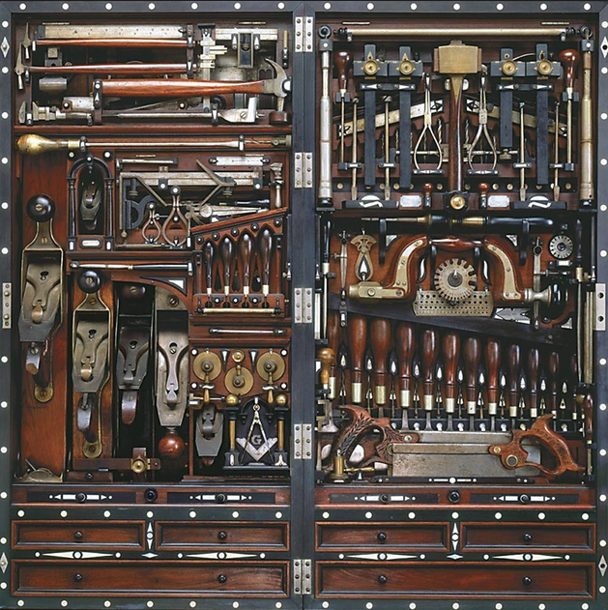
Repertoire of Primal Leadership
Visionary
Coaching
Affiliative
Democratic
Pacesetting
Commanding
Goleman, D., Boyatzis, R. E., & McKee, A. (2002). Primal leadership: Realizing the power of emotional intelligence. Boston, Mass: Harvard Business School Press.
Notes:
Let’s look then, at the qualities that are most useful when implementing primal leadership strategies. If you look closely the the a la carte menu you have, and the styles that most closely reflect who you think you are, they more than likely fit within this broader framework. Hopefully you have at least one style from the a la carte list that loosely fits within each of these broader concepts:
Visionary-A positive trait that is most appropriate when change is imminent and requires a new vision or when a clear direction is needed.
Coaching-A highly positive trait that is required for improving employee performance by building on long term capabilities.
Affiliative-A positive trait that creates harmony among people. It heals rifts in teams, motivates during stressful times and is used to strengthen connections.
Democratic-Also positive, it values people’s input and gets commitment through participation. Appropriately used to build buy-in or consensus.
Pacesetting-It’s effective for meeting challenging and exciting goals, but must be used with caution. It is frequently poorly executed and therefore outcomes can be highly negative.
Commanding-Also highly misused, can result in negative outcomes. However, used with caution can sooth fears by giving clear direction in an emergency.

Slide 12

Resonance finding what works
Can you identify your style(s)?
What style resonates with your work environment?
  Is that style resonate or dissonant with your own style?
What leadership framework resonates with you as an individual?
  What aspects of the framework don’t?
Goleman, D., Boyatzis, R. E., & McKee, A. (2002). Primal leadership: Realizing the power of emotional intelligence. Boston, Mass: Harvard Business School Press.
Notes:
Can you identify your style? Or your strengths? Is something feeling right, or really wrong? Hopefully your instincts have kicked in and you can identify with one or more of the characteristics represented in the Primal Leadership repertoire. Of equal importance is whether or not you can identify your work environment’s overall climate. Take a close look, is your style resonant or dissonant with your environment? How might being off balance with your environment affect performance?-In a nutshell, when people are put off balance by their leader, they perform poorly. What can you do to align yourself and achieve resonance within your environment? Start with your self awareness-the number one component to increasing your Emotional Intelligence, then identify a leadership framework that helps you to organize your strategies for successful leadership. Try a few frameworks on for size. Maybe it’s the Four Frames, maybe it’s Primal-maybe it is something else you’ve found that makes sense to you. Experiment and examine your outcomes.
Look for opportunities to generate excitement, optimism, and passion as well as opportunities to cultivate an atmosphere of cooperation and trust. Use your new found self-awareness, self-management, social awareness, and relationship management to gauge your resonance or dissonance within your organization.

Slide 13

Other frameworks to consider
Transformational
Situational
Organizational
Transactional
Behavioral
        To name only a few….
Notes:
As I just mentioned, frameworks like the two we have discussed are only two of an endless array to choose from. Do a little research and you’re sure to find one that works for you. In general the frameworks fit within just a few theories. Knowing these can help you decide where to begin.
Leadership theories tend to be: Transformational, Situational, Organizational, Transactional or Behavior in nature.
In Transformational leadership the leader is charged with identifying the needed change, creating a vision to guide the change through inspiration, and executing the change in tandem with committed members of the group.
The fundamental underpinning of the situational leadership theory is that there is no single "best" style of leadership. Effective leadership is task-relevant, and the most successful leaders are those who adapt their leadership style to the maturity or capacity of the individual or group they are attempting to lead or influence.
In Organizational Leadership leaders must perform five primary functions: monitor the environment, organize subordinate activities, train and coach subordinates, motivate followers, and participate in the group's work.
Transactional leadership arises from an individual's ability to reward or punish subordinates based on their performance. Leaders must be given a goal, must possess the ability to train and evaluate subordinate's performance towards that goal and must be given the authority to reward subordinates when goals are met.
Behavior Leadership-Successful leadership is based in definable, learnable behavior

Slide 14

Becoming a leader:
Self Discovery & Creating Change
Who do I want to be?
What are my strengths and gaps?
How can I build on my strengths while reducing my gaps?
Practice new behaviors, thoughts and feelings to the point of mastery
Develop supportive and trusting relationships that make change possible
Goleman, D., Boyatzis, R. E., & McKee, A. (2002). Primal leadership: Realizing the power of emotional intelligence. Boston, Mass: Harvard Business School Press.
Notes:
Okay, so you’ve chosen a few adjectives from a list, a few things that seem to define you where you are at right now. But is that it? Isn’t there more? Is it enough? Or do you have an idea of who you want to become? Do you have a vision? Take some time to define your ideal self, or who it is you want to become. Following that take an inventory-what are your perceived strengths and gaps? Ask a trusted advisor to evaluate your answers, be prepared to hear about how you might be perceived. Then think: how can I build on my strengths, how can I use them to face the current challenges in my workplace? Where can I close the gaps on my weaknesses? What resources do I have available to me to close those gaps?
Here’s where the rubber meets the road: in order to make any change stick you have to have a plan and put it into practice. You have to practice and adjust, practice and adjust. Practice, as they say makes permanent. Leadership is deliberate and requires preparation
Finally, find a mentor, or that trusted advisor to provide you feedback on the actions you are taking. Do they see a change in your approach to leadership or even to the problems you are facing or, do they think you can do more-what do they suggest?
Also, never forget to continue on with professional development in order to support and buttress your evolution in leadership. Becoming an expert in leadership is a persistent endeavor.

Slide 15

Library Leadership
Reluctant leadership-Don’t want to be the captain? What other roles need leadership in the organization?
For tenure, leadership is often required-what can you do?
Lack of promotional/organizational opportunity-where do you look?
Leading “up”- influencing those around & above you by knowing your style.
Notes:
Maybe you’re not a manager or supervisor in your current position. Or, maybe you are but you hadn’t planned on it. Are you a reluctant leader? What roles come to mind that require leadership in libraries and how might one overcome their reluctance or fear of assuming that role?
Leadership is often a criteria that is required for tenure. What are a few things that one might do to fulfill that criteria in libraries?
What can you do if there are no obvious opportunities to lead within your library? Where else might you look and what else might you do?
How do you think knowing your style can assist you with influencing the people you work with? If you are not currently managing people or projects and you want to, what skills can you use to impress upon your administration that you are ready for the job?

Slide 16
Works Cited & Resources
Goleman, D., Boyatzis, R. E., & McKee, A. (2002). Primal leadership: Realizing the power of emotional intelligence. Boston, Mass: Harvard Business School Press.
Boyatzis, R.E., & McKee, A. (2006). Intentional Change. Journal of Organizational Excellence, Summer, pp. 49-60. doi: 10.1002/joe
Gallos, J. V. (2006). Reframing complexity: A four dimensional approach to organizational diagnosis, development, and change. In J.V. Gallos (Ed.), Organizational Development: A Jossey-Bass Reader . Retrieved from http://www.joangallos.com/wp-content/uploads/2007/08/reframing-complexity-a-four-dimensional-approach.doc
Lee Bolman - http://www.leebolman.com/index.html
Joan V. Gallos - http://www.joangallos.com/

